Slide 1



WQD7008 Project
Image processing with Hadoop in raspberry pi cluster

Slide 2
Lecturer: dr. Hamid tahaei Team members: WQD180041 - MUHAMMAD HAFIZ BIN KHAIRUDIN WQD190039 - JONATHAN KOW YEE SENG WQD170100 - SYAIFUL ANUAR BIN ABD LATIF WQD180061 - XUXIANG WQD180027 - LIM SHIEN LONG

Slide 3
Introduction
This project was chosen to demonstrate the power of edge computing combined with distributed storage and processing using easily accessible hardware and open source software.
A broad range of application is possible, and for this project we chose images as our input data type. Using image files we will describe and demonstrate:
The project methodology – block diagram of the whole flow.
How we built a cluster of machines to implement Hadoop distributed storage & processing framework.
How an application sitting on the ‘edge’ could transfer data to a distributed system (using Node-RED).
How image processing is done using an image processing framework built on MapReduce.

Slide 4
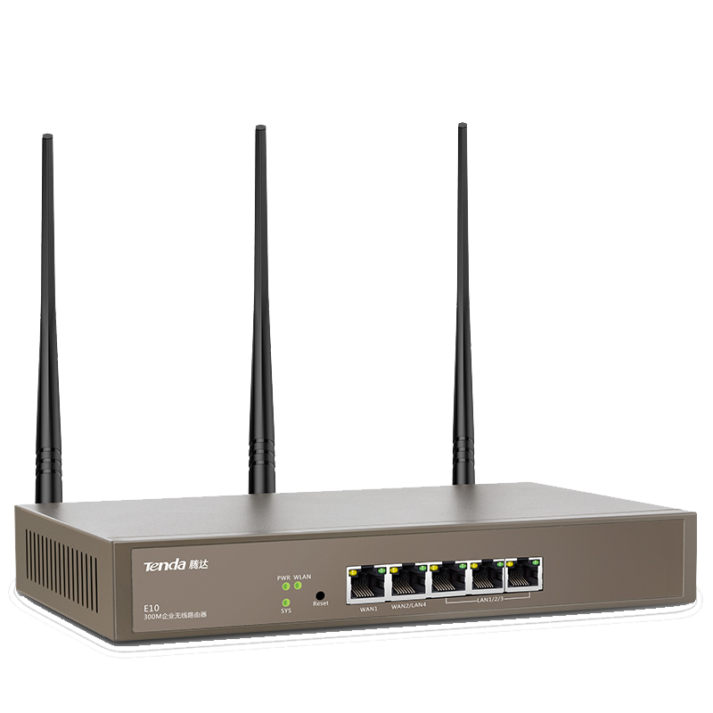



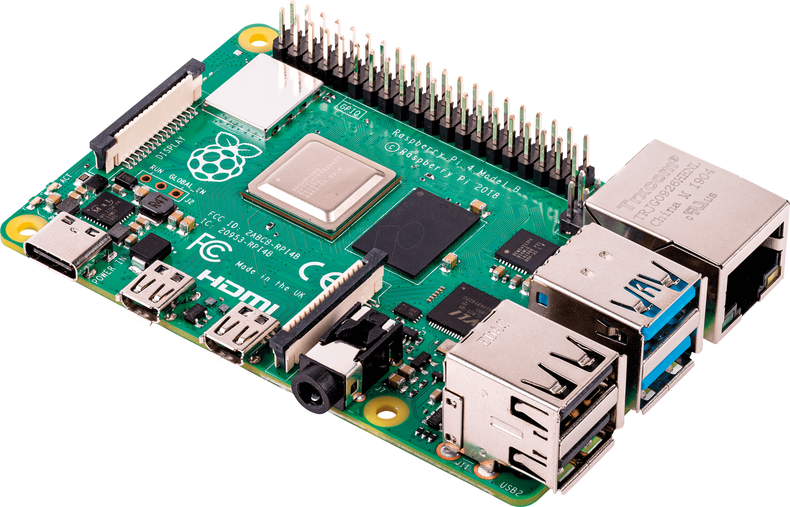



HARDWARE & SOFTWare
Raspberry Pi 4 Model B 4GB

Slide 5
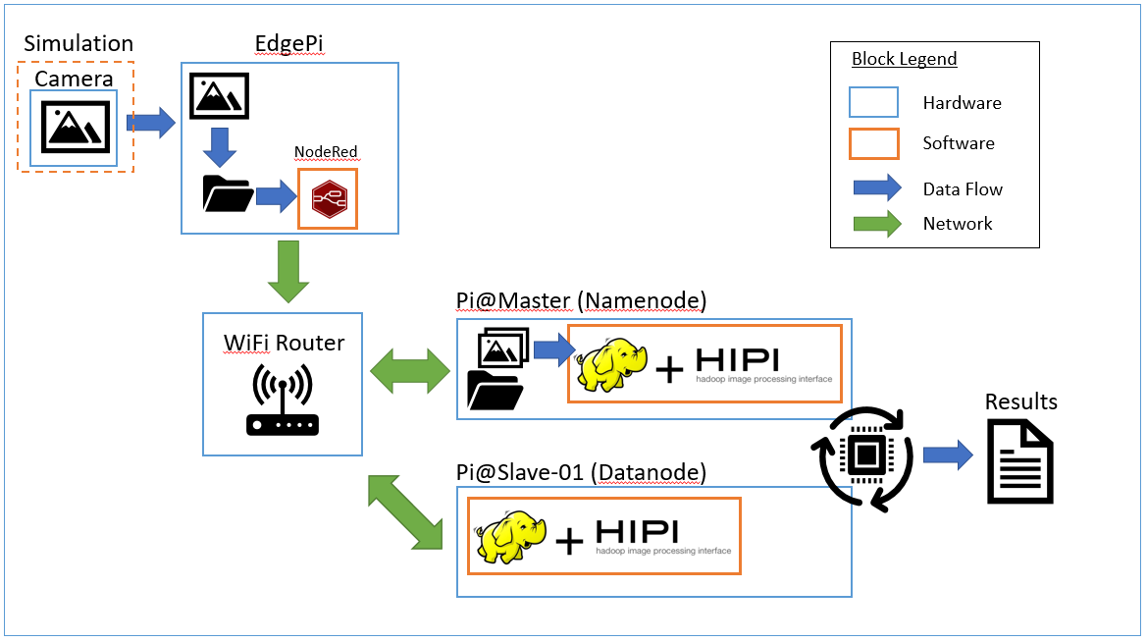
Methodology

Slide 6
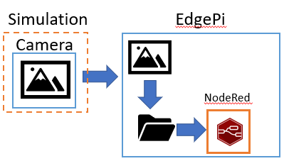
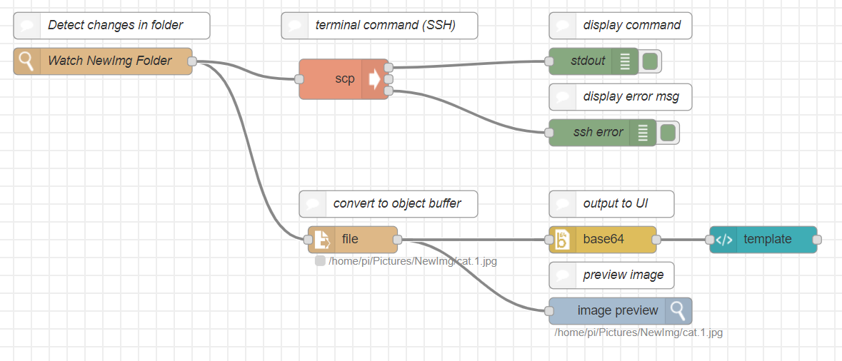
Phase 1& 2 – edge node & data transfer
H/W: Raspberry Pi
S/W: Node Red
Watches for new images to be ‘taken’ and added to folder
Send image through network using SSH to Master
Preview image & convert image object to base64 display on dashboard

Slide 7




Phase 3 – Image processing
hib
index
Initiate HDFS to store images transferred from edge node
HibImport tool in HIPI will then convert images into its primary input type (Hipi Image Bundle, HIB)
MapReduce stage:
Mapper: compute the average pixel color over a single image
Reducer: sum up the averages and divide by their count to compute the total average pixel color
RGB

Slide 8



RESULT
Average Pixel Value:
R – 0.000102
G – 0.006789
B – 0.487370

Slide 9




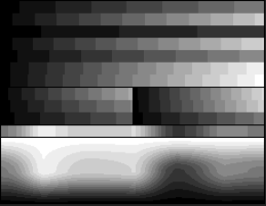
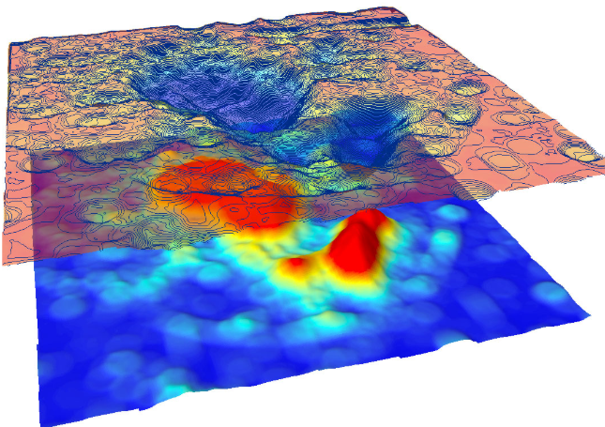

Future work - Classification
Image Processing
OR

Slide 10
THANK YOU
Q&A

